Slide 2
Building, Running, Patching Docker Containers – The Paradigm Shift
Steve Lasker
Program Manager – Azure Developer Experiences
@stevelasker
BRK2115
Notes:
Building Resilient Microservices with .NET Core and Azure Container Services (AKS)
Code: BRK2141
Type: Breakout 45 minute
Track(s): Applications and Infrastructure
Speaker(s): Glenn Condron, Steve Lasker
Timeslot: Monday, May 7 2:45 PM-3:30 PM
Abstract:Microservices are highly scalable, resilient, and composable units of deployment for modern applications. But building them is hard. There are a lot of development and deployment considerations to take into account. In this session we'll show you how we're making .NET Core microservices easier to build with new application patterns in .NET Core 2.1 as well as how to deploy and manage them with Kubernetes and Helm.

Slide 3
Containers are a way to wrap up an application into its own isolated box. This isolation empowers Developers and IT Operations to collaborate effectively as they have clear boundaries of configuration and execution. Come learn how adopting a container workflow and lifecycle management empowers change and stability from the first release. As a developer, you’ll see testing your build pipeline, before you commit your code and how the build pipeline is used for OS & Framework patching during and after active development. Come see how containers are a paradigm shift to a modern DevOps workflow, that will take some change, but empowers your company to new levels of collaboration. Also learn how to use Azure Container Registry (ACR) build to simplify container development and building by easily storing and managing container images for Azure deployments in a central registry

Slide 4
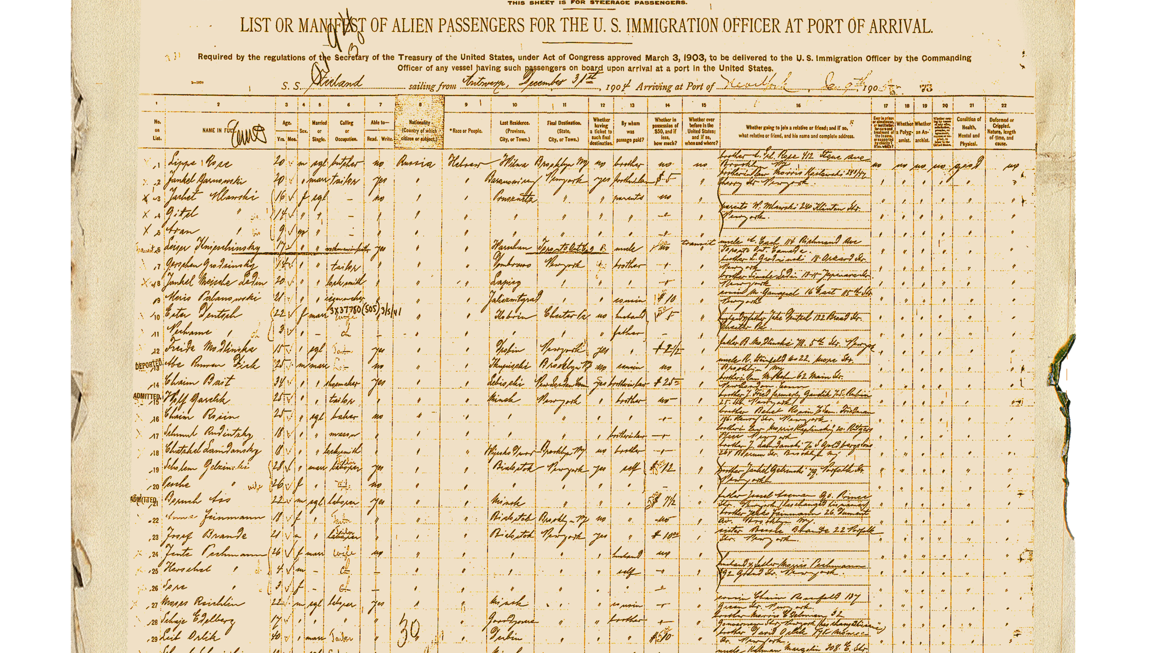
Shipping Manifest
Building
Building your code, with a container first mindset
Running
Prepare your code to run
Deploying updates to your code
Patching
Patching – the paradigm shift
Reaping the rewards of your efforts

Slide 5



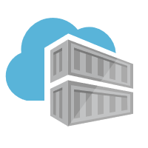


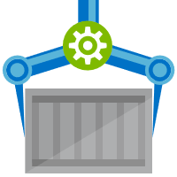
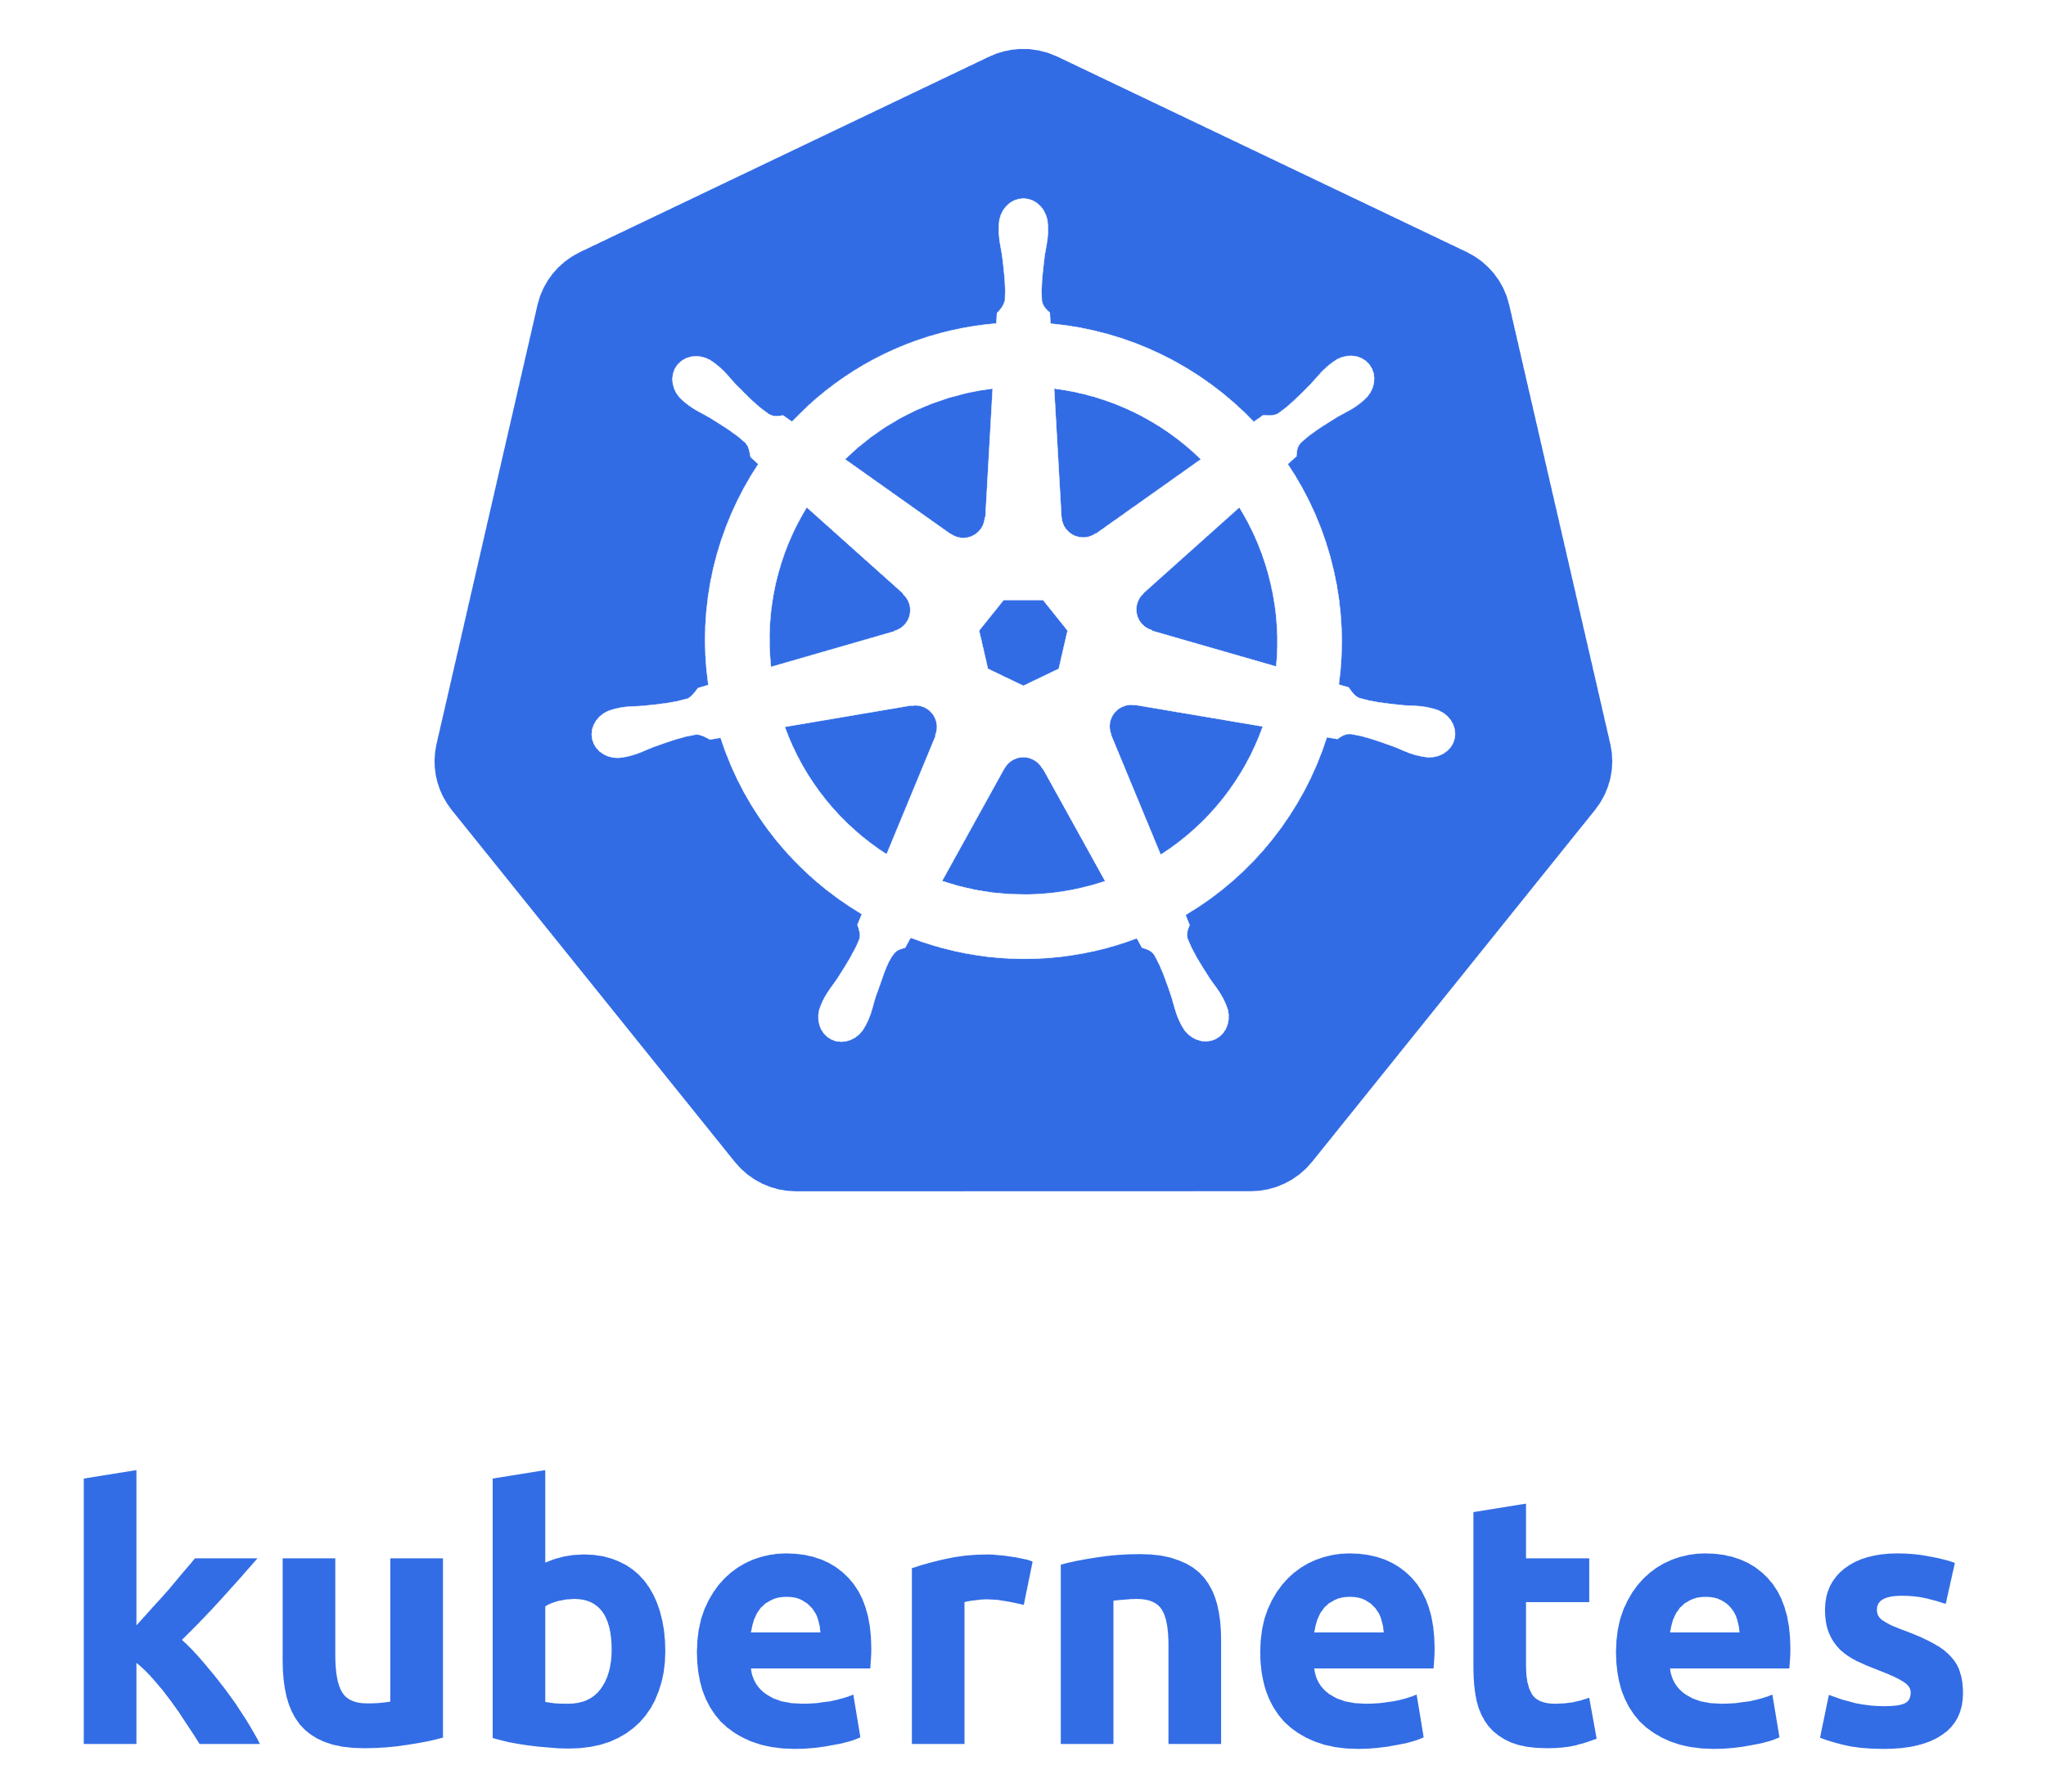



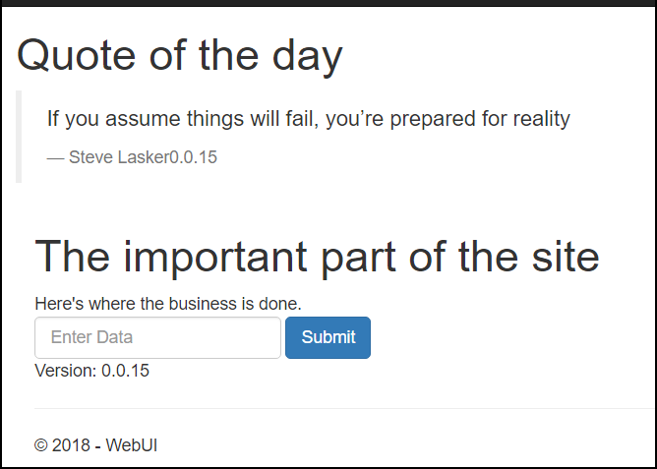
Demo Reference Architecture
Registries
Docker Hub
MCR
ACR
web
web
quotes -api
queue- worker
/Demo
quotes -api
queue- worker
ACR Build
ACR Geo-replicated
East US
Important System
web
web
web
quotes-api
queue-worker
quotes -api
queue- worker
quotes -api
queue- worker
Important System
West Europe

Slide 6


Release Management
Resource Pool
Orchestration
HOST-A
Deploy:
web:1 x3
quotes:1 x3
important:1 x4
Image Cache
3
web:1
digest: 91e
web:1
digest: 91e
Foo:
web:1 x3
quotes:1 x3
important:1 x4
web:1
digest: 91e
quotes:1
digest: u82
Container Builder
important:1
digest: 2re
important:1
digest: 2re
Container Registry
HOST-B
Image Cache
quotes:1
digest: u82
quotes:1
digest: u82
7
6
quotes:1
digest: u82
5
web:1
digest: 91e
important:1
digest: 2re
important:1
digest: 2re
important:1
digest: 2re
quotes:1
digest: u82
1
quotes:1
digest: u82
docker build –t web:1
docker build –t quotes:1
docker build –t important:1
docker push web:1
docker push quotes:1
docker push important:1
important:1
digest: 2re
important:1
digest: 2re
Image
web:1
quotes:1
important:1
2
Digests
91e
u82
2re
web:1
digest: 91e
HOST-C
quotes:1
digest: u82
4
important:1
digest: 2re
8
Image Cache
quotes:1
digest: u82
quotes:1
digest: u82
important:1
digest: 2re
important:1
digest: 2re
Notes:
Orchestrator icon from: http://cdn.marketplaceimages.windowsphone.com/v8/images/f58edb21-b20c-4315-b837-6cee21n442cd?imageType=ws_icon_large
https://git-scm.com/book/en/v2/Git-Branching-Basic-Branching-and-Merging

Slide 7

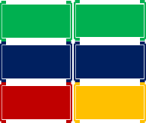
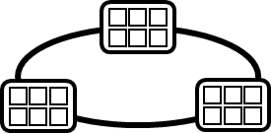


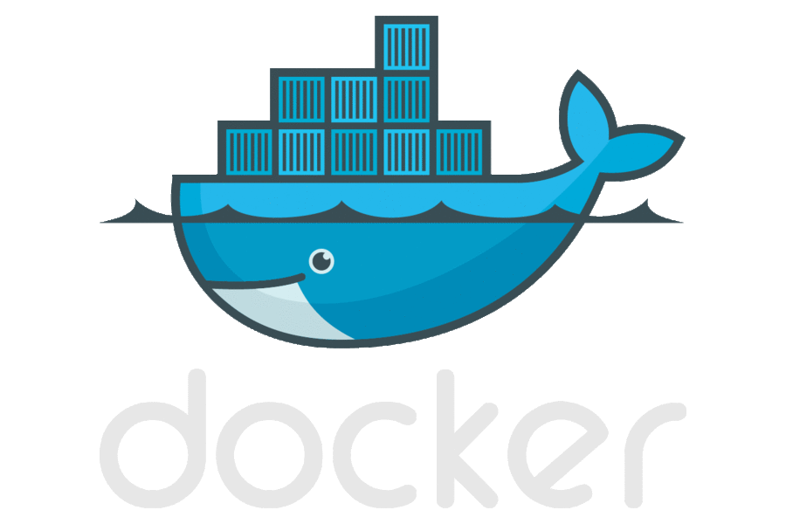

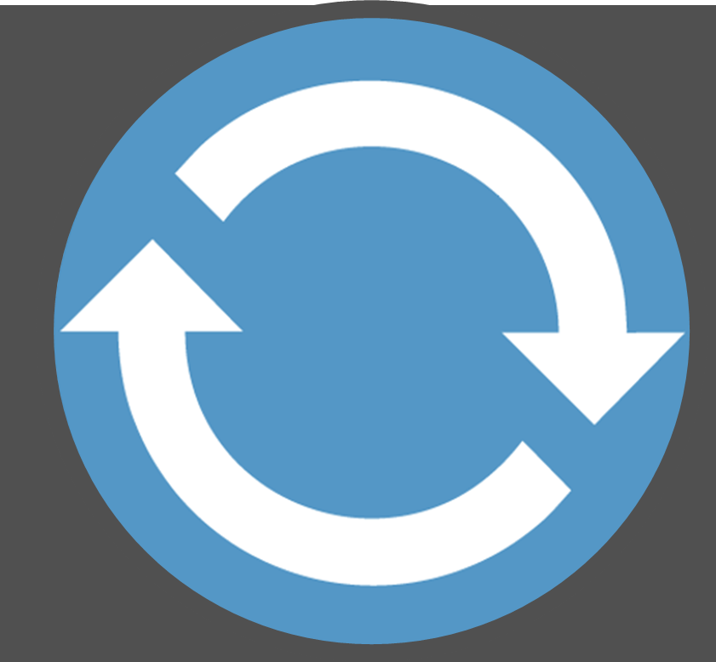

Today’s Container DevOps Workflow
Container Service
OS & Framework Patching
What happens when developers stop making code changes?
Run, Manage
Container Instances
Source Code Control
(SCC)
Build/CI,
Integrate,
Test
CD, Deploy
App Services
Production
environments
Service Fabric
Azure Functions
IoT
Inner-Loop
Azure Batch
Run
Monitor and Diagnose
Code
Validate
Debug

Slide 8
Build

Slide 9
Demo
Docker Build
Docker Run
…the inner loop

Slide 10
Docker Multi-Stage Builds
FROM microsoft/aspnetcore:2.0 AS base
WORKDIR /app
FROM microsoft/aspnetcore-build:2.0 AS build
WORKDIR /src
COPY HelloWorld.sln ./
COPY HelloWorld/HelloWorld.csproj HelloWorld/
RUN dotnet restore -nowarn:msb3202,nu1503
COPY . .
WORKDIR /src/HelloWorld
RUN dotnet build -c Release -o /app
FROM build AS publish
RUN dotnet publish -c Release -o /app
FROM base AS final
WORKDIR /app
COPY --from=publish /app .
ENTRYPOINT ["dotnet", "HelloWorld.dll"]
dotnet build
copy source
ENTRYPOINT ["dotnet", "HelloWorld.dll"]
nuget restore
COPY --from=publish /app
COPY .csproj
final
COPY .sln
microsoft/aspnetcore-build
microsoft/aspnetcore
dotnet publish
publish

Slide 11
Configuration

Slide 12

Extracting Configuration
A build image shall be deployable across multiple environments
Container Builder
Container Registry
Important
Integration
Staging
Prod-Marketing
Prod-Finance
web:1
Prod-MFR
web:1
web:1
web:1
web:1
docker build –t web:1
docker push web:1
web:1
Web:1
Web:1
Web:1
Web:1
Web:1
Integration
Staging
Prod-Marketing
Prod-Finance
Prod-Mfr

Slide 13
Demo
Configuration Provider - extracting settings from your container

Slide 14
Committing Code
Are you ready to deploy?
Can your container be built?
What about configuring build systems…

Slide 15





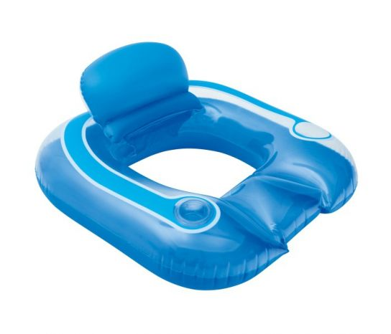
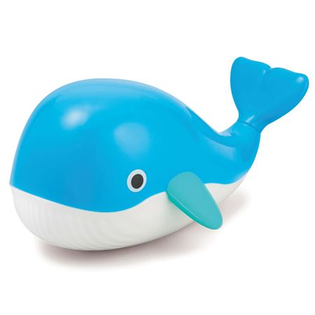



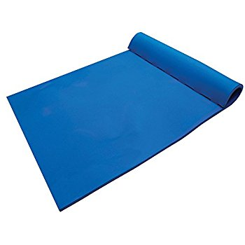
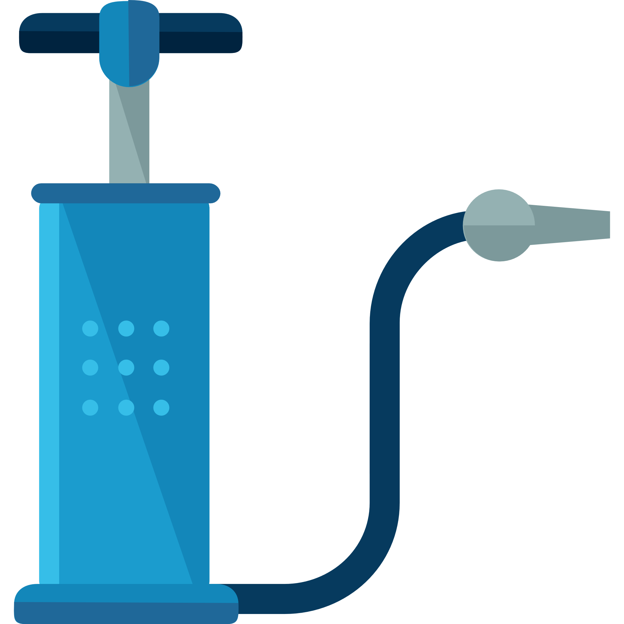



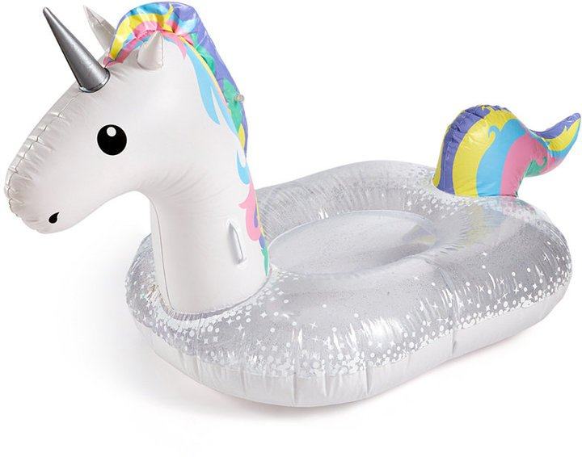
Current Build Infrastructure
Build, Integrate, Test
Hosted Build Agent Pool
Contoso – Build Pool
Northwind – Build Pool

Slide 16
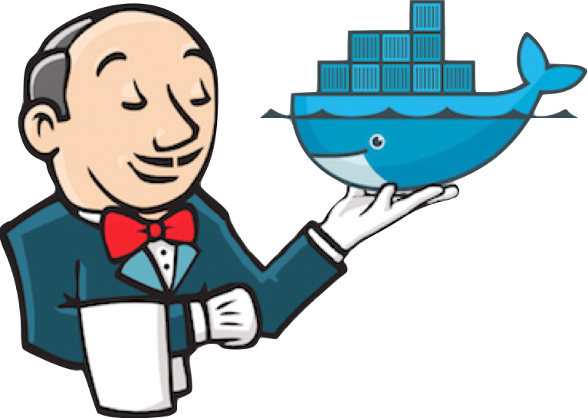
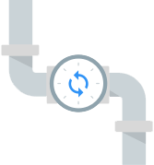


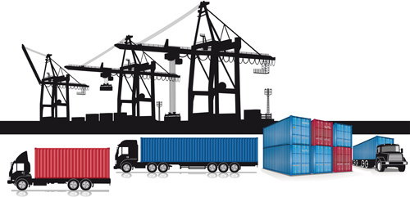
Container Builds - using a Container Mindset
Build, Integrate, Test
Hosted Build Agent Pool

Slide 17
Announcing ACR Build A primitive of container lifecycle management
aka.ms/acr/build

Slide 18
Today’s Container DevOps Workflow
Container Service
Run, Manage
Container Instances
Source Code Control
(SCC)
Build/CI,
Integrate,
Test
CD, Deploy
App Services
Production
environments
Service Fabric
Azure Functions
IoT
Inner-Loop
Azure Batch
Run
Monitor and Diagnose
Code
Validate
Debug

Slide 19



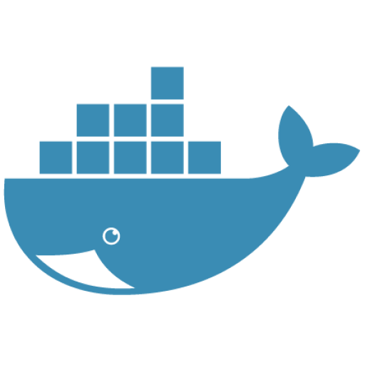


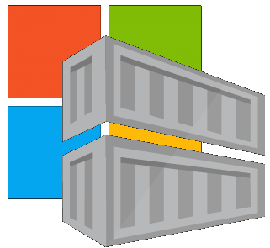
Container Lifecycle Primitives
Host agents monitor, protect and report running containers
3
Container Service
Container Instances
Source Code Control
(SCC)
Build/CI,
Integrate,
Test
CD, Deploy
7
App Services
Upon release, set released flag in ACR (ACR-Auto-purge policies)
Service Fabric
.NET
6
Base Image Index
4
8
1
2
Azure Functions
Docker Hub
ACR Build
Azure Container Registry
IoT
Azure Container Registry
Image Security Scanning
Secure by default
Microsoft Container Registry
Inner-Loop
Azure Batch
Run
5
Code
Validate
Debug
* Work in progress

Slide 20


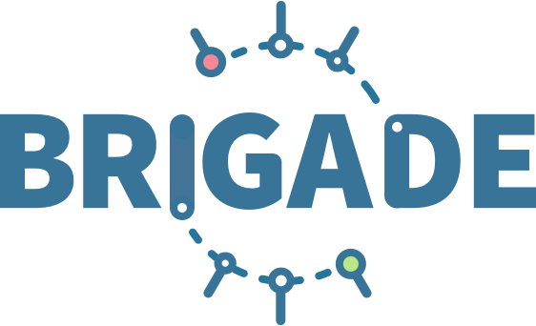
ACR Build: Container OS & Framework Patching
.NET
Registries
Docker Hub
MCR
ACR
Build Triggers
SCC Providers
ACR Build
Azure Container Registry
aka.ms/acr/build

Slide 21
Demo
ACR Build
Inner loop
trigger builds on git commits
but, wait, there’s more…

Slide 22
ACR Build
Native Container Builds
Follows docker build semantics
docker build –t helloworld:uniqueid1234 .
az acr build –t helloworld{{.Build.ID}} .
Inner-loop pre check-in validations
Trigger based builds (git commits, base image updates)
az acr build-task create –-image demo42/helloworld{{.Build.ID}}
--name myBuildTask
--registry jengademos
--context https://github.com/demo42/helloworld
--branch completedish
--git-access-token $PAT

Slide 23
Testing Built Containers…

Slide 24
Testing Built Containers
FROM microsoft/aspnetcore-build:2.0 AS builder
ARG BuildConfiguration=Release
WORKDIR /src
COPY *.sln ./
COPY Web/Web.csproj Web/
RUN dotnet restore
COPY . .
WORKDIR /src/Web
RUN dotnet build -c $BuildConfiguration -o /app
FROM builder AS publish
ARG BuildConfiguration=Release
RUN dotnet publish -c $BuildConfiguration -o /app
FROM microsoft/aspnetcore:2.0 AS base
WORKDIR /app
EXPOSE 80
FROM base AS production
WORKDIR /app
COPY --from=publish /app .
ENTRYPOINT ["dotnet", "Web.dll"]
FROM microsoft/aspnetcore-build:2.0 AS builder
ARG BuildConfiguration=Release
WORKDIR /src
COPY *.sln ./
COPY Web/Web.csproj Web/
RUN dotnet restore
COPY . .
WORKDIR /src/Web
RUN dotnet build -c $BuildConfiguration -o /app
FROM builder AS test
WORKDIR /src/Web.test
RUN dotnet test
FROM builder AS publish
ARG BuildConfiguration=Release
RUN dotnet publish -c $BuildConfiguration -o /app
FROM microsoft/aspnetcore:2.0 AS base
WORKDIR /app
EXPOSE 80
FROM base AS production
WORKDIR /app
COPY --from=publish /app .
ENTRYPOINT ["dotnet", "Web.dll"]
Unit Tests
Multi-stage dockerfiles

Slide 25
Demo
Testing in containers

Slide 26
Testing Built Containers
FROM microsoft/aspnetcore:2.0 AS base
WORKDIR /app
EXPOSE 80
FROM microsoft/aspnetcore-build:2.0 AS builder
ARG BuildConfiguration=Release
WORKDIR /src
COPY *.sln ./
COPY Web/Web.csproj Web/
RUN dotnet restore
COPY . .
WORKDIR /src/Web
RUN dotnet build -c $BuildConfiguration -o /app
FROM builder AS test
WORKDIR /src/Web.test
RUN dotnet test
FROM builder AS publish
ARG BuildConfiguration=Release
RUN dotnet publish -c $BuildConfiguration -o /app
FROM base AS production
WORKDIR /app
COPY --from=publish /app .
ENTRYPOINT ["dotnet", "Web.dll"]
Unit Tests
Multi-stage dockerfiles
Functional Tests
Test containers
test:1
web:1
Functional Testing w/Helm & Kubernetes
- Dan Garfield Codefresh.io
test:1
web:1
Integration Env

Slide 27
Run

Slide 28
Deploying & Managing “Unreliable” Systems

Slide 29
Service Boundary Definition
Helm Charts
Kubernetes application deployment declaration
A set of “files” that describe the intent of what you want deployed
Values to fill in for incremental deployments
Name & Version
Collection of expandable Go templates, used to generate a Kubernetes Deployment file ^{(Similar to T4)}
Solves dynamic values used for each deployment
Chart.yaml
Values.yaml
\templates
webapp.yaml
quotesapi.yaml
secrets.yaml
_helpers.tpl
\charts
nginx-ingress-0.12.0.tgz
Custom template, for not-yet-known standards
A complete chart for an existing thing
RabbitMQ, NGINX, Jenkins

Slide 30
Helm – what are the controls you need to know?
Initial Deployment
helm install [directory] –n [instanceName]
Upgrading an existing deployment
helm upgrade [instanceName] [updatedContentDirectory]
helm upgrade demo42-int .
--reuse-values \
--set [name]=value

Slide 31
Patch

Slide 32


Dockerfile FROM
Functional Tests
Base Images
Commit Id
Build-task
Id
Context
Dependencies
ACR
d5ab1fa
fx:1
fx:1^{(a)}
fx:1
Web-Build
1
fx:1
web:sha@la
web:1
deploy/test
deploy
web:1
web:1
test:t
Context
d5ab1fa
test:1
Dependencies
web:1
Integration Env
FROM jenga.azurecr.io/baseimages/fx:1
COPY . /output
EXPOSE 80
ENTRYPOINT ["entryPoint"]
If docker build succeeds (including any unit tests),
Save the context & base image dependencies
web:1
az acr build-task create \
–n Web-Build \
–t web:${{.Build.ID}} \
–c github.com/demo42/web \
–-git-access-token $PAT \
–r jenga
Staging Env

Slide 33
Dockerfile FROM
Functional Tests
Base Images
Commit Id
Build-task
Id
Context
Dependencies
ACR
fx:1^{(a)}
fx:1
d5ab1fa
Web-Build
1
fx:1
web:sha@la
web:1
deploy/test
deploy
Context
fx:1^{(b)}
fx:1^{(b)}
2
fx:1^{(b)}
web:sha@ya
web:2
deploy/test
deploy
web:2
web:2
d5ab1fa
test:2
test:2
Dependencies
fx:1^{(a)}
web:2
fx ships an OS &/or FX Patch, using the stable 1 tag
The build-task is monitoring changes based on the last build
Integration Env
Base image updates restore the previous context
If Build & Unit Tests Succeed,
Update the base image dependencies
web:2
Staging Env

Slide 34
Dockerfile FROM
Functional Tests
Base Images
Commit Id
Build-task
Id
Context
Dependencies
ACR
fx:1^{(a)}
d5ab1fa
Web-Build
fx:1
fx:1
Web-Build
1
web:sha@la
web:1
deploy/test
deploy
Context
fx:1^{(b)}
fx:1^{(b)}
2
fx:1^{(b)}
web:sha@ya
web:2
deploy/test
deploy
web:2
web:2
ef26q5c
test:2
d5ab1fa
test:3
fx:2^{(d)}
fx:2^{(d)}
fx:2
ef26q5c
3
fx:2^{(d)}
web:sha@qe
web:3
deploy/test
deploy
web:3
web:3
Dependencies
test:4
Dependencies
fx:1^{(a)}
fx:1^{(b)}
web:3
FROM jenga.azurecr.io/baseimages/fx:2
COPY . /output
EXPOSE 80
ENTRYPOINT ["entryPoint"]
Integration Env
web:2
web:3
If docker build succeeds (including any unit tests),
Save the context & base image dependencies
Staging Env
Container OS & Framework Patching

Slide 35
Demo
Base Image Updates
enabling :
OS & Framework Patching
Notes:
High-level, walk through a helm chart
Helm upgrade

Slide 36
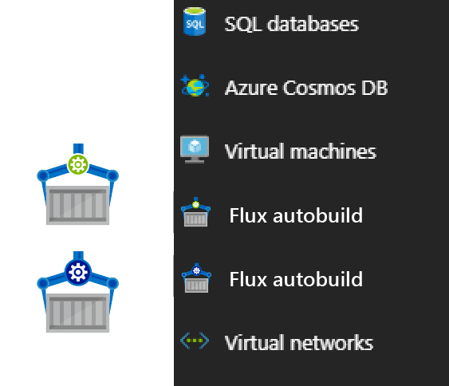


Contoso (Returns)
1 Pull Request
= 1 Build
= 1 Push
= 1 Scan
= 1 Test
= 1 Deploy
$$(1pr=1b+1p+ 1t+1d) ∗life of development$$
Contoso (*)
= 1 Build
= 1 Push
= 1 Scan
= 1 Test
= 1 Deploy
= 1 Build
= 1 Push
= 1 Scan
= 1 Test
= 1 Deploy
= 1 Build
= 1 Push
= 1 Scan
= 1 Test
= 1 Deploy
.NET
Northwind
= 1 Build
= 1 Push
= 1 Scan
= 1 Test
= 1 Deploy
= 1 Build
= 1 Push
= 1 Scan
= 1 Test
= 1 Deploy
= 1 Build
= 1 Push
= 1 Scan
= 1 Test
= 1 Deploy
Smart Hotel 360
= 1 Build
= 1 Push
= 1 Scan
= 1 Test
= 1 Deploy
= 1 Build
= 1 Push
= 1 Scan
= 1 Test
= 1 Deploy
= 1 Build
= 1 Push
= 1 Scan
= 1 Test
= 1 Deploy
Adventure Works
= 1 Build
= 1 Push
= 1 Scan
= 1 Test
= 1 Deploy
= 1 Build
= 1 Push
= 1 Scan
= 1 Test
= 1 Deploy
= 1 Build
= 1 Push
= 1 Scan
= 1 Test
= 1 Deploy
Fabrikam
= 1 Build
= 1 Push
= 1 Scan
= 1 Test
= 1 Deploy
= 1 Build
= 1 Push
= 1 Scan
= 1 Test
= 1 Deploy
= 1 Build
= 1 Push
= 1 Scan
= 1 Test
= 1 Deploy
$$1patch=cust ∗apps ∗ \left(1b+1p+ 1t+1d\right)∗life of the app$$

Slide 37
Image Tagging
Why stable tagging can create instability

Slide 38
HOST-A
Deploy:
web:1 x3
quotes:1 x3
important:1 x4
Image Cache
3
web:1
digest: 91e
web:1
digest: 91e
Foo:
web:1 x3
quotes:1 x3
important:1 x4
web:1
digest: 91e
quotes:1
digest: u82
quotes & important are in inconsistent states
1
important:1
digest: 2re
important:1
digest: 2re
docker build –t web:1
docker build –t quotes:1
docker build –t important:1
docker images
REPOSITORY TAG DIGEST
web 1 91e
quotes 1 u82
important 1 2re
docker push web:1
docker push quotes:1
docker push important:1
HOST-B
Image Cache
quotes:1
digest: u82
quotes:1
digest: u82
9
8
web:1
digest: 91e
5
important:1
digest: 2re
quotes:1
digest: 3rp
important:1
digest: 1n4
important:1
digest: 2re
quotes:1
digest: u82
quotes:1
digest: u82
important:1
digest: 2re
important:1
digest: 2re
Digests
91e
u82
2re
Image
web:1
quotes:1
important:1
2
Digests
91e
u82
2re
3rp
1n4
web:1
digest: 91e
HOST-C
quotes:1
digest: u82
7
4
important:1
digest: 2re
Image Cache
quotes:1
digest: 3rp
quotes:1
digest: 3rp
6
docker build –t quotes:1
docker build –t important:1
docker images
REPOSITORY TAG DIGEST
quotes 1 3rp
important 1 1n4
docker push quotes:1
docker push important:1
important:1
digest: 1n4
important:1
digest: 1n4
quotes:1
digest: 3rp
important:1
digest: 1n4
Notes:
Orchestrator icon from: http://cdn.marketplaceimages.windowsphone.com/v8/images/f58edb21-b20c-4315-b837-6cee21n442cd?imageType=ws_icon_large
https://git-scm.com/book/en/v2/Git-Branching-Basic-Branching-and-Merging

Slide 39
Demo
Deploying Stable Tags Creates Instability

Slide 40
Tagging Techniques
Base Images
FROM …
Stable Tags
Tag
:latest
:1
:2
:3
:1.0
:1.1
:1.2
:2.0
:2.1
:3.0
Digest
91efj6
u82lq
2re7f
3rpn1
1n4ef
5wd1k
Servicing Stable Tags
Tag
:latest
:1
:2
:1.0
:1.1
:1.2
:2.0
Digest
91efj6
u82lq
e8s1f
1n4ef
2re7f
3rpn1
28efq
Deployed Images
docker run …
Unique Tagging
Tag
:12204
:12328
:12401
:33810
:35091
:4201
:50201
Digest
91efj6
u82lq
e8s1f
1n4ef
2re7f
3rpn1
28efq
Notes:
[‎2/‎23/‎2018 3:18 PM] Sajay Antony:
https://git-scm.com/book/en/v2/Git-Branching-Basic-Branching-and-Merging
[‎2/‎23/‎2018 3:37 PM] Sajay Antony:
https://docs.docker.com/storage/storagedriver/
[‎2/‎23/‎2018 4:00 PM] Sajay Antony:
https://www.cockos.com/licecap/
[‎2/‎23/‎2018 5:10 PM] Sajay Antony:
https://docs.docker.com/datacenter/dtr/2.4/guides/user/create-promotion-policies/

Slide 41
Image Tagging
Base Images
Deployed Images
Always Unique
Stable Tags create instability
Build IDs are a great source
$BuildSystem-{{.Build.ID}}
%Y%m%d-%H%M%S
aa-10192409
bb1833583
demo42mfr-305305t035
Stable Tags
:latest
:1.0
:1.1.1.1
:2.0
:2.2.1

Slide 42
Coming into port…
If You Accept failure as the norm, and you’ll sleep well at night
Containers are immutable
Containers have an OS & Framework
Patching Containers, means building, testing, deploying patched containers
Automated Tests are like fluffy pillows
Automate Builds, without tests, are beds without pillows
Deploying Stable Tags, leads to Instability
Docker Tagging: Best practices for tagging and versioning docker images

Slide 43
Info
Azure Kubernetes Service: aka.ms/kubernetes
Brigade: aka.ms/acr/brigade
Helm: aka.ms/helm
ACR Build ^{(Preview)} aka.ms/acr/build
ACR Geo-Replication ^{(GA)} aka.ms/acr/geo-replication
Presentations: aka.ms/acr/presentations
Demo42: github.com/demo42
Blog blogs.msdn.microsoft.com/SteveLasker
Twitter @SteveLasker
Email SteveLas@Microsoft.com

Slide 44
Related Breakout Sessions
.NET Platform
Visual Studio
Azure
Monday BRK2100 .NET Overview and Roadmap
Tuesday
BRK2151 What's new in Web Development with ASP.NET Core 2.1
BRK2147 Meet the new stack for real-time web communication: ASP.NET Core SignalR
BRK2155 The Future of C#
Wednesday
BRK2144 Entity Framework Core 2.1: Simple, Powerful Data Access for .NET
Monday
BRK2134 The Present and Not-too-distant Future of Visual Studio
BRK2152 What's new with Visual Studio for Mac
Wednesday
BRK2145 Get in the Zone: Visual Studio 2017 Productivity Enhancements
BRK2148 Supercharge your debugging in Visual Studio 2017
Tuesday
BRK2115 Building, Running, Patching Docker Containers – The Paradigm Shift
BRK2117 Diagnosing and debugging live cloud applications
Wednesday
BRK3810 Modernizing existing .NET applications with Windows Containers and Azure cloud

Slide 45

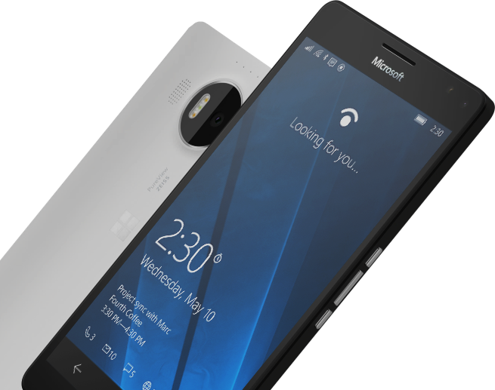
Please Complete An Evaluation Form for every session you attend. Your input is important!
#MSBuild

